Slide 1
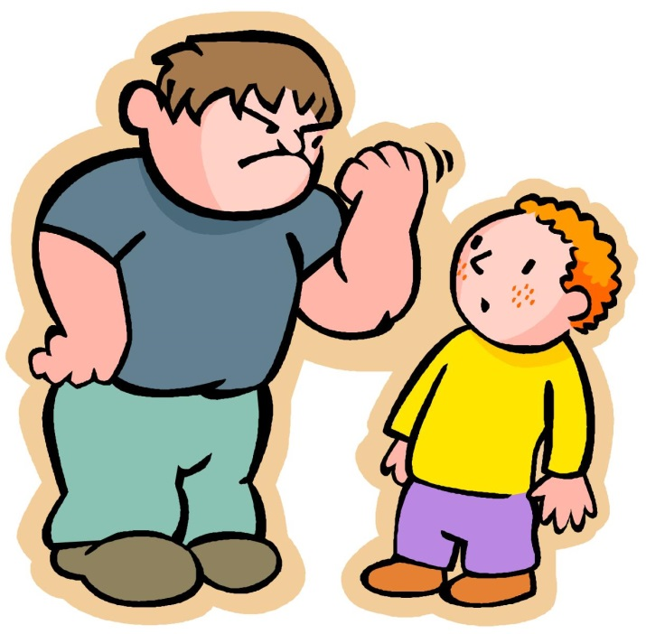
Bullying
By: Alberta Gaspar

Slide 2
Definition
Bullying: is an unwanted, aggressive behavior among aged children and teenagers that involves a real or perceived imbalance of power the behavior may also be repeated frequently or it has the potential to be repeated over time.
In order for it to be considered bullying there are three things that have to be involved which is persistence, over power, and doing it on purpose meaning you don’t care who you hurt. http://www.ncab.org.au/parents/typesofbullying/

Slide 3
Types of bullying
Physical bullying: physical bullying is when you kick, trip, pinch, push or damage the persons property and all with intention.
Verbal bullying: includes name calling, insults, teasing, intimidation, homophobic or racist comments, or verbal abuse.
Covert or hidden bullying: this type of bullying is probably the hardest one to recognize and can be carried out behind the bullied persons back, this type of bullying is designed to harm someone's reputation or cause humiliation in front of their peers.
Cyberbullying: it could be overt or covert bullying behaviors using digital technology, including hardware like computers, or mobile devices they could also use social media, instant message or text, cyber bullying could happen at any time, and sometimes it can be in private but it can also be in public with only the person that is being targeted knowing. http://www.ncab.org.au/parents/typesofbullying/

Slide 4
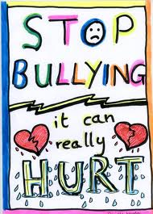
Actions of bullying
Making threats to the person
Verbal abuse
Attacking them physically
Leaving them out of a group on purpose
And doing all of this with intention.

Slide 5
Roles played
Bully: which is the person that does the harm to someone else.
Victim: which is the one that is getting bullied.
Bystander: the person that decides to avoid the situation either because they think it’s the right thing to do or because it’s the best thing for them personally.
http://www.stopbullying.gov/what-is-bullying/roles-kids-play/index.html

Slide 6
Targeted kids
A shy person may be a bigger target because they are shy to socialize with other people so they may get bullied.
A kid with a disability or a health problem may also be one of the bigger targets to be bullied, a kid with a disability because he might be seen as different to other people, and a kid with a health problem because they might not be able to do things that other kids could do.

Slide 7
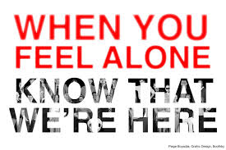
Signs of a victim of bullying
unexplainable injuries.
Lost or destroyed clothing
Faking illness
Eating habits may change
Difficulty sleeping
Losing interest in school
loss of friends
Their self-esteem may decrease

Slide 8
Signs of a bully
may get into physical or verbal abuse frequently.
May have friends that are bullies towards other children.
They are increasingly aggressive.
Go into the principals office a lot or get detention a lot.
The may have extra money

