Slide 1
Theocracy
By: Alberta Gaspar and Lane neaman

Slide 2
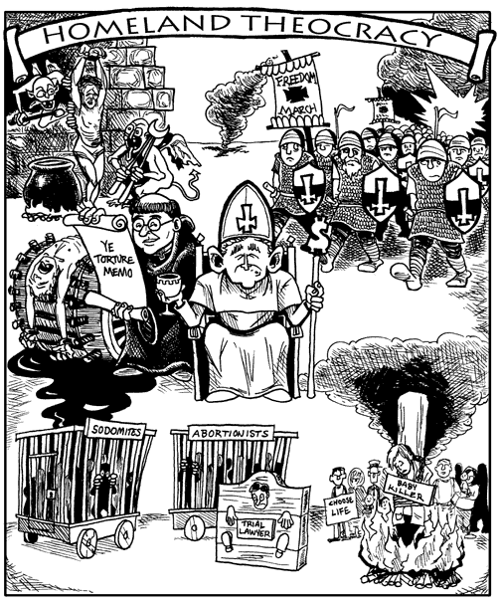
Definition
Theocracy is a type of government in which priests rule in the name of god or a god.

Slide 3
Key theorists
Amon the varieties of theocracy are those of ancient times such as those that existed among the Hebrews, and other ancient kingdoms such as those of the pharaohs, Assyrians, Babylonians and the Cretans.
Bishops ruled for decades or centuries in the absence of any civil government.

Slide 4
Why it is the best way of government
The law proclaimed by the ruler is also considered a divine revelation and hence the law of god.
They thought that this was the best way of government because it was gods choice and that they should not go against gods will.

Slide 5
Structure of government
The government proclaims it rules on behalf of god or a high power, as specified by the government institutions and laws.
The person that has the power is a priest or anyone that says they had a vision of god telling them they should be the ruler

Slide 6
How power is gained
Power is gained by voting by the people but before they vote they pray to hear who god thinks is the right person to vote for to gain power.
Another way power was gained was that you had a relative that was already a ruler and it was inherited.
Someone also has a vision and that could be a way for the person to gain power.

Slide 7
Roles of citizen
Citizens had to follow gods laws and the roles are very limited.

